Slide 1

飞利浦KA菜谱小程序升级迭代&菜谱维护项目：流程图；设计稿
Philips KA Delicacy WeChat Mini Program's Upgrade&Maintenance: Diagrams&Main Functions
Shanghai CRMCLICK Technology Co., Ltd.

Slide 2
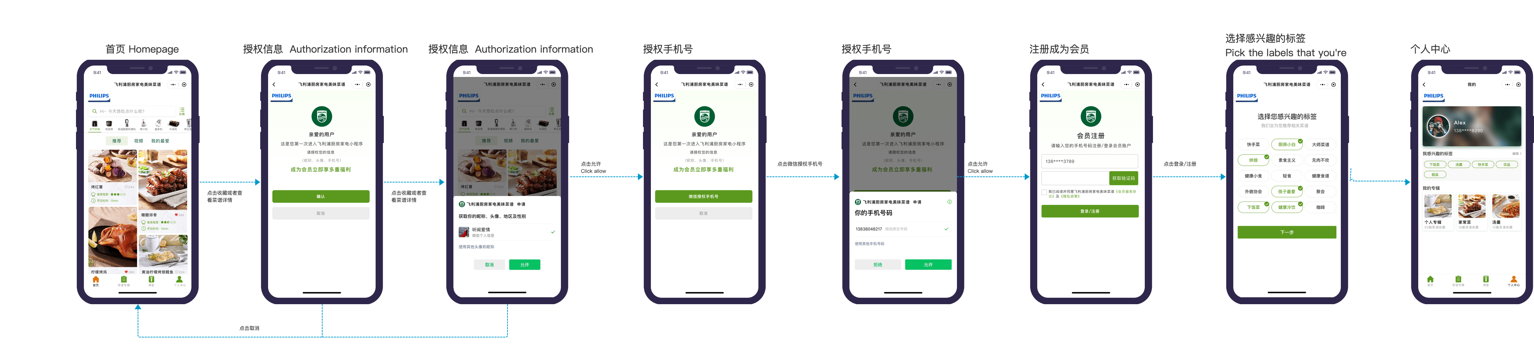
用户授权信息
注册会员
User's Flow

Slide 3
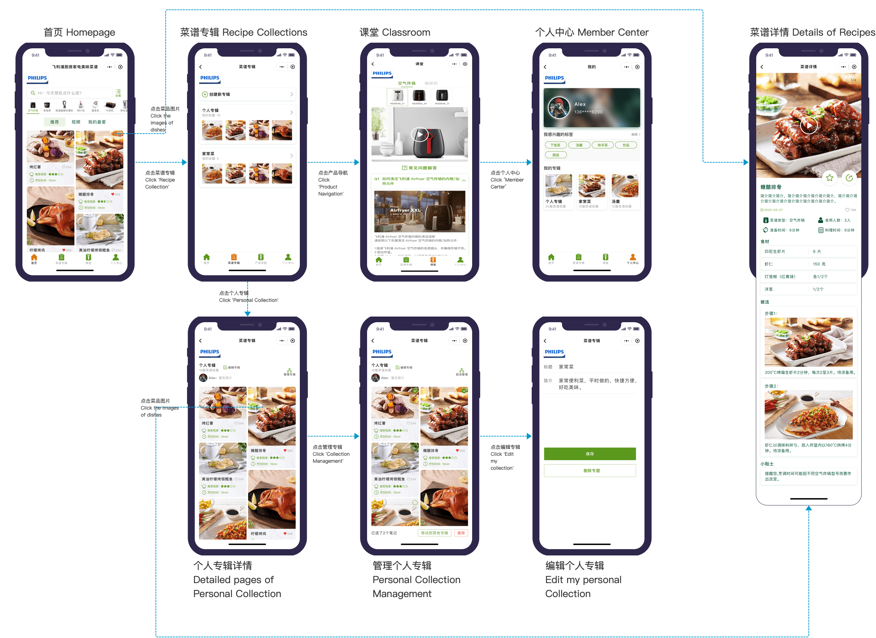
用户路径
User's Flow

Slide 4
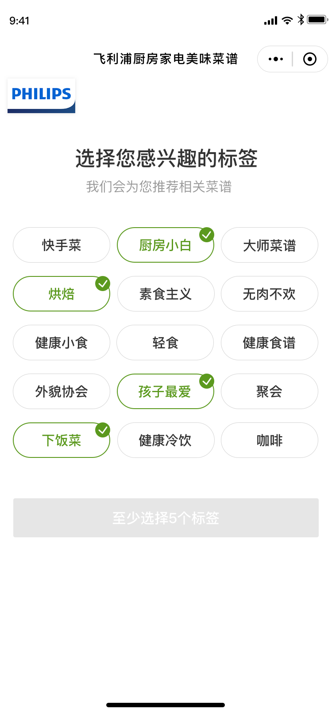
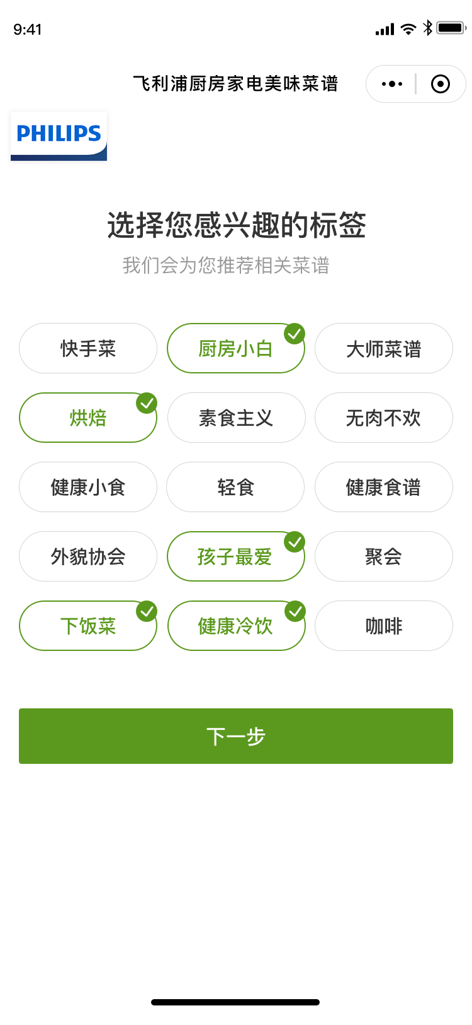
首次进入小程序，选择感兴趣的标签
Picking labels that one is interested in when first entering
选择您感兴趣的标签，我们会为您推荐相关菜谱
Please select the labels that you're interested in and we'll recommend you related recipes
至少选择5个标签
Please select at least 5 labels

Slide 5
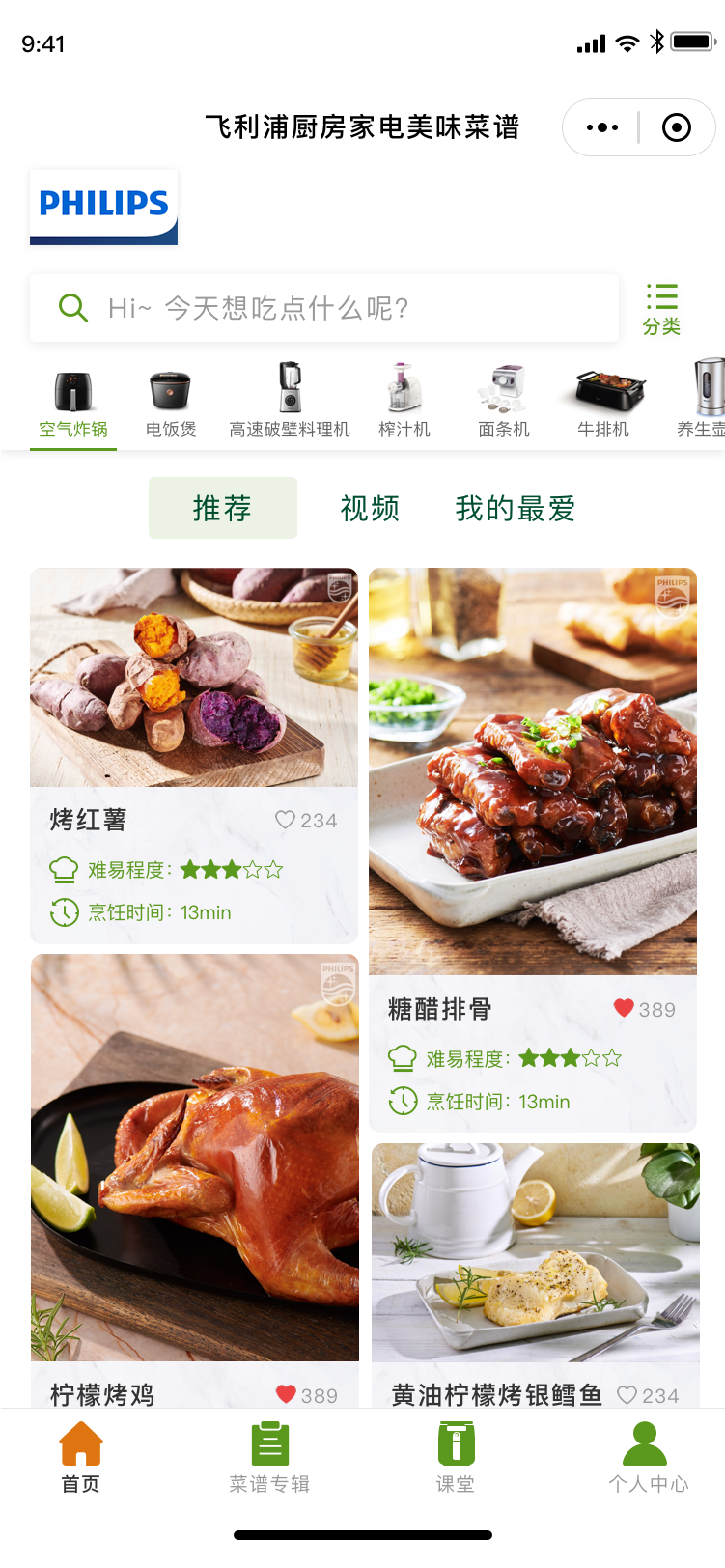
小程序首页
Homepage
搜索框：搜索感兴趣的菜谱
Searching Bar: search for recipes that you're interested in
分类：通过类别标签进行筛选搜索
Category: filtering by selecting category labels
产品导航：根据不同厨电用品寻找相应菜谱
Product Navigation: search corresponding recipes by different kitchen appliances
点击浏览“推荐/视频/我的最爱”分类
Click and view 'Explore/Video/My Favourite'
菜品图片 Image of the dishes
烹饪时间 Required time
收藏：点击爱心收藏 菜谱
My Collection: click the heart shaped icon to add the recipe into collection
难易程度 Difficulty Level
菜品名称 Name of the dishes
首页
Homepage
菜谱专辑
Recipe Collection
产品导航
Product Navigation
个人中心Member Center

Slide 6
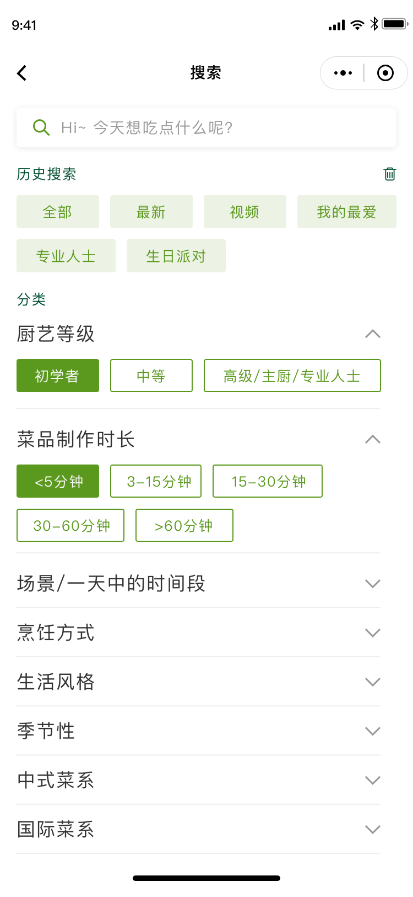
搜索
Searching
搜索框：搜索感兴趣的菜谱
Searching Bar: search for recipes that you're interested in
删除历史 Clear history
历史搜索记录 Search history
标签筛选搜索：点击下拉箭头查看更多标签
Label filtering: Click the drop-down arrow to see more labels
*可同时选择多个标签
*Multiple labels can be selected at the same time
*菜谱根据评分高低排列显示
*The menu is arranged and displayed according to the user's rating

Slide 7
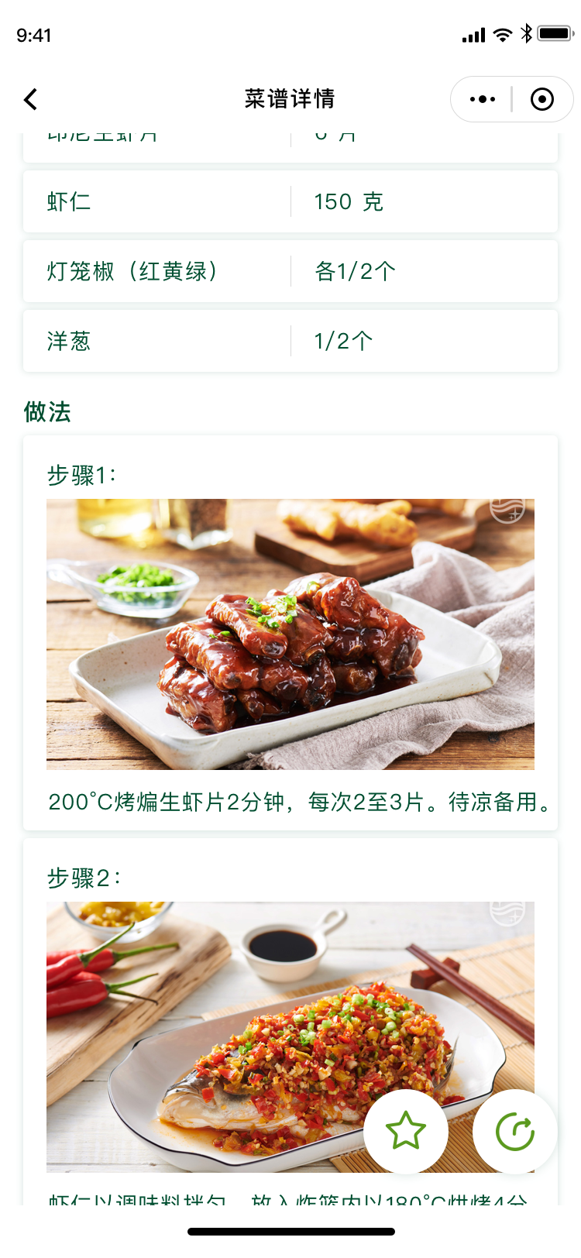
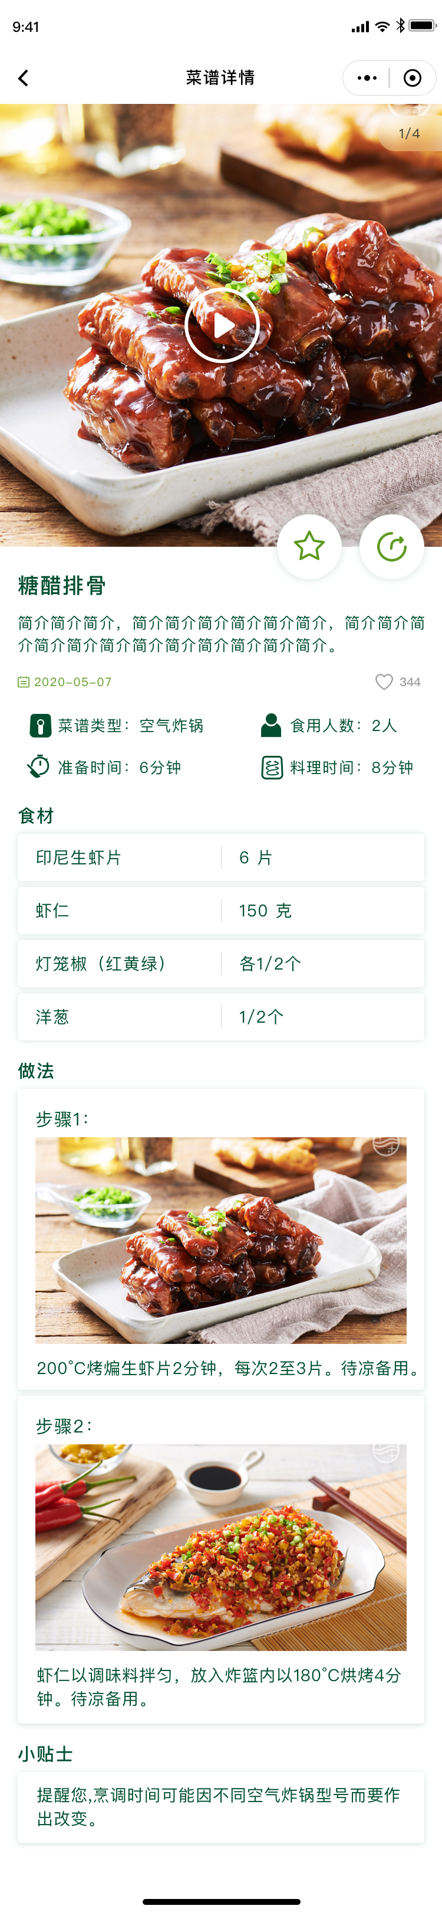
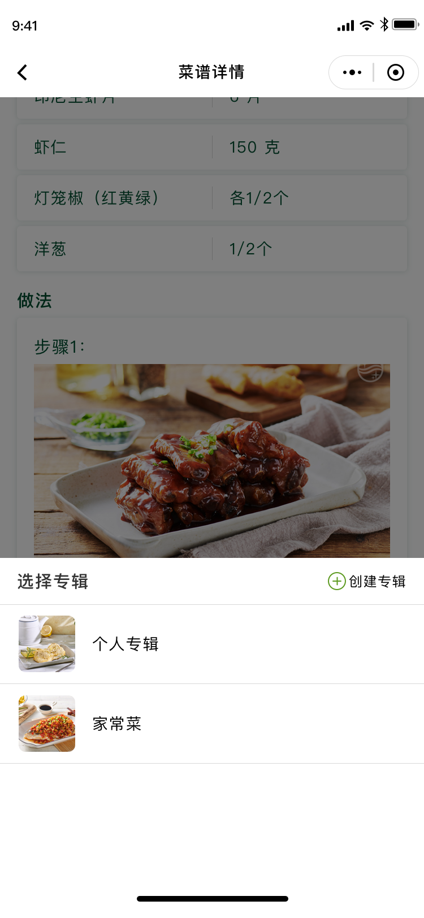
菜谱详情
Details of Recipes
所需材料&数量
Required ingredients&the amount
菜品静图/动图/视频，可左右切换
png/gif/videos of dishes（slide to see more）
收藏：加入专辑
Click the star-shaped icon to add this recipe into collection
菜品名称&简介
Name&brief introduction of dishes
分享 Share button
收藏与转发图标会随着页面下滑而移动
The collect and share button will always float in the bottom right corner of the page
菜谱类型/食用人数/准备时间/料理时间
Type of recipe/Dishes for how many people/Time for prepare/Time for cooking
料理步骤
Cooking steps
点击收藏，选择收藏至已有或新建专辑
Add recipes into existed collections or a newly-created collection
烹饪贴士
Cooking tips

Slide 8
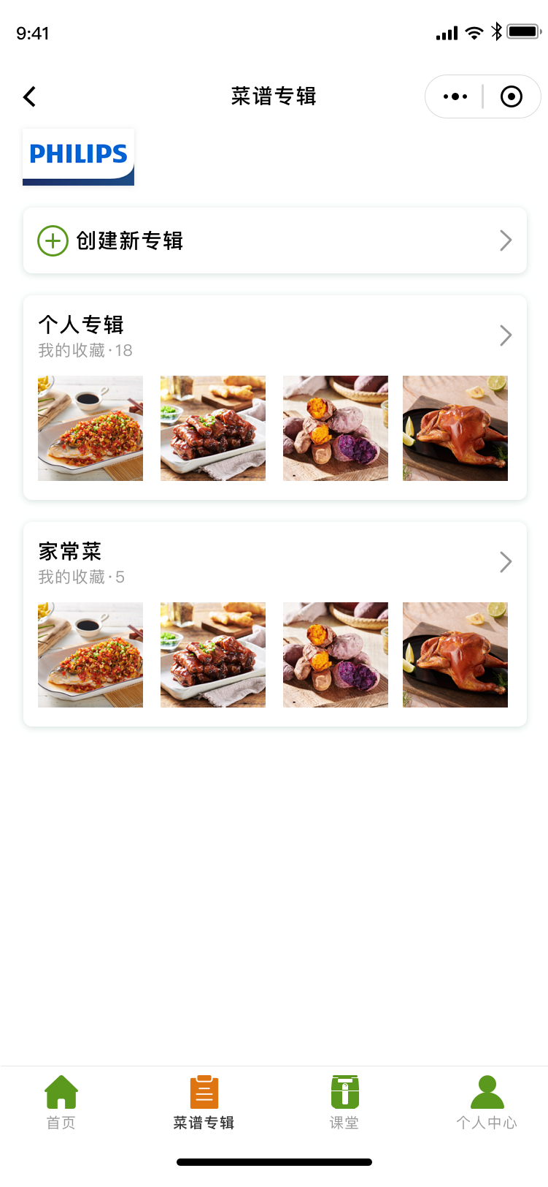
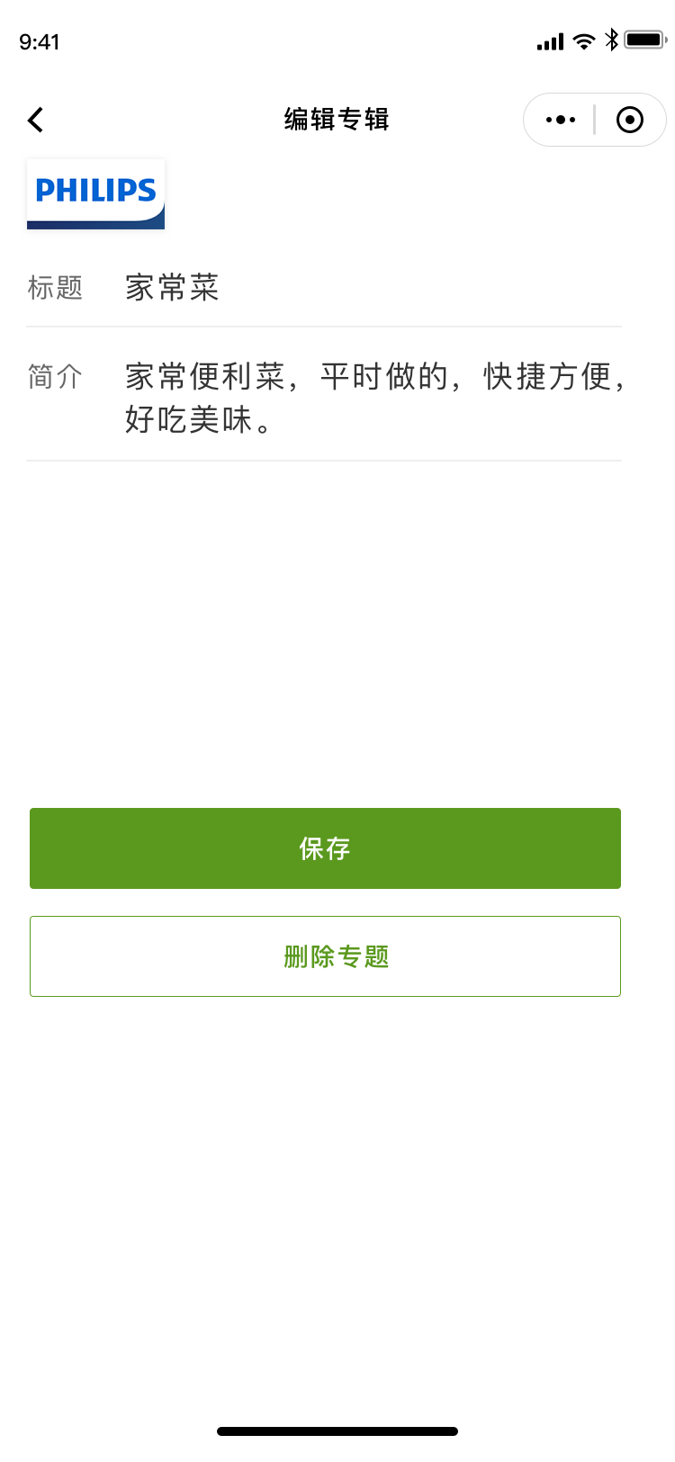
菜谱专辑
Recipe Collection
填写专辑标题 Fill in collections' name
创建新专辑 Create new collections
填写专辑简介 Fill in collections' brief introduction
已创建专辑 Existed collections
保存 Save

Slide 9
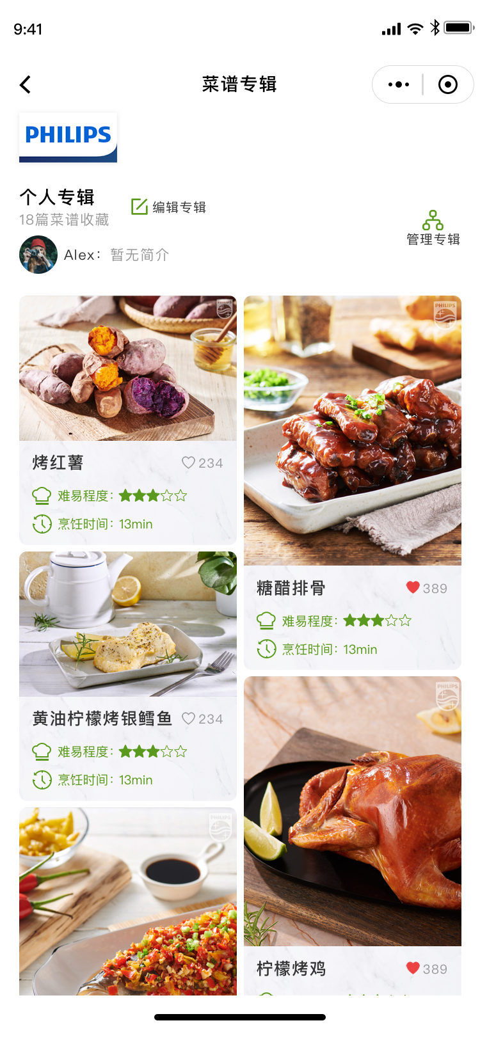
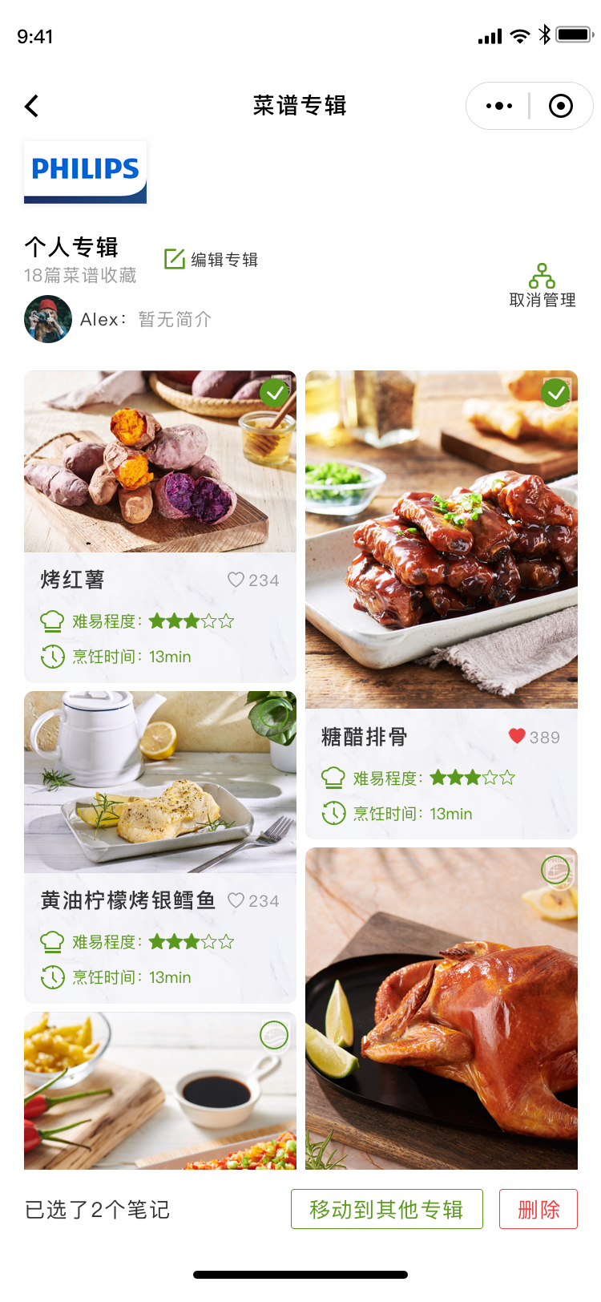
管理专辑：删减或移动菜谱至其他专辑
Mangage the collection: delete recipes and move recipes to other collections
菜谱专辑
Recipe Collection
编辑专辑：修改专辑标题与简介
Edit the collection: modify the name and introduction of this colleciton
点击菜谱右上角圆形，勾选菜谱进行移动或删除
Select the circle on the upper right corner to move or delete
删除专辑 Delete collection
显示已勾选菜单数量
Display the number of selected recipes
移动到其他专辑
Move to other collection
删除
Delete

Slide 10
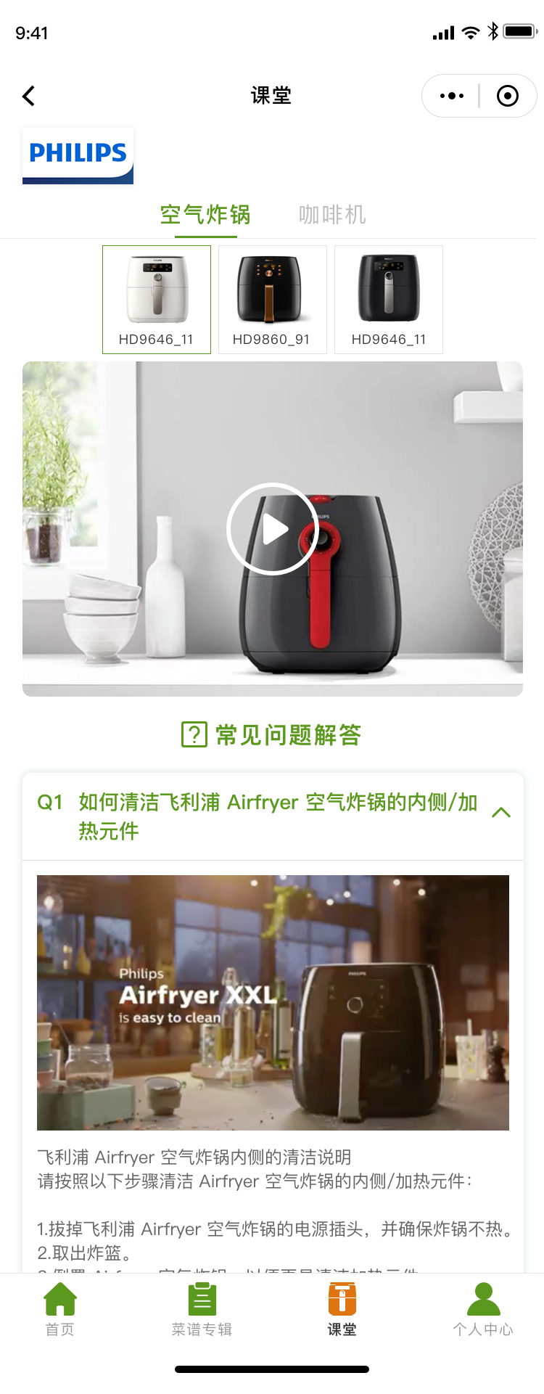
课堂 Class

Slide 11
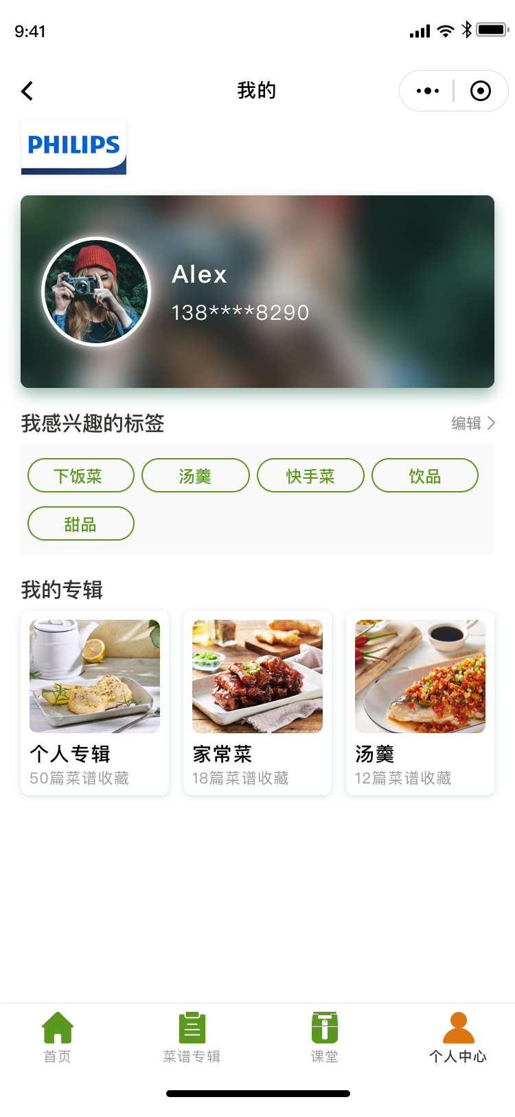
我的
Member Center
用户头像与昵称
User's pofile picture&name
编辑 Edit button
我感兴趣的标签
Labels that I'm interested in
我的专辑
My Collections

